Slide 1


High Frequency Satellite Communication Transmitter
Tzur Bar-Cochva
Peretz Porath
Supervised by Denis Dikarov

Slide 2
Overview
Abstract
Main challenges
Main features
Full System Block Diagram
Theory
PLL
Quadrature (IQ) Modulation
Design
PLL Design
IQ Modulator (Upconverter) Design
Conclusions

Slide 3
Abstract
High frequency transmitter for satellite communication in K-band.
X-microwave boards and connectors based on “LEGO-Like” technology.
Analog Devices PLL and Upconverter.
Space-To-Earth Communication – Challenges of the wireless channel.
Applications – Maritime vessels, off-grid distant locations, etc.
Robustness and noise mitigation.

Slide 4
Main Challenges
System Design – tradeoffs, versatility and performance.
Integration – new technology, limited components selection, use of X-microwave modules.
Noise – high frequency, wideband, complex system which holds modules with an elaborate interface
Unfamiliar fields of study – RF Systems, Digital Communications, System Design, Board Design.
Work with new design tools – OrCAD Capture, PCB Editor, VISIO, ADIsimPLL, etc.

Slide 5
Main Features
Frequency range within K-band – 25.5-27 [GHz].
Carrier frequency at RF output – 26.25 [GHz].
Analog Devices IQ modulator (upconverter) with integrated x4 (quadruple) of the Local Oscillator.
Analog Devices PLL frequency synthesizer generates – Local Oscillator output at 6.5625 [GHz].
Two RF PCBs of a LEGO like X-microwave technology - the IQ Modulator and the PLL modules.
SPI-Controlled IQ Modulator with variable attenuator.
SPI-Controlled PLL with variable LO frequency with Fractional-N divider.
Crystal Oscillator frequency source – 100 [MHz]
Overall low noise system – with robustness to phase noise and white noise by differential signaling and meticulous filtering design of PCBs.

Slide 6
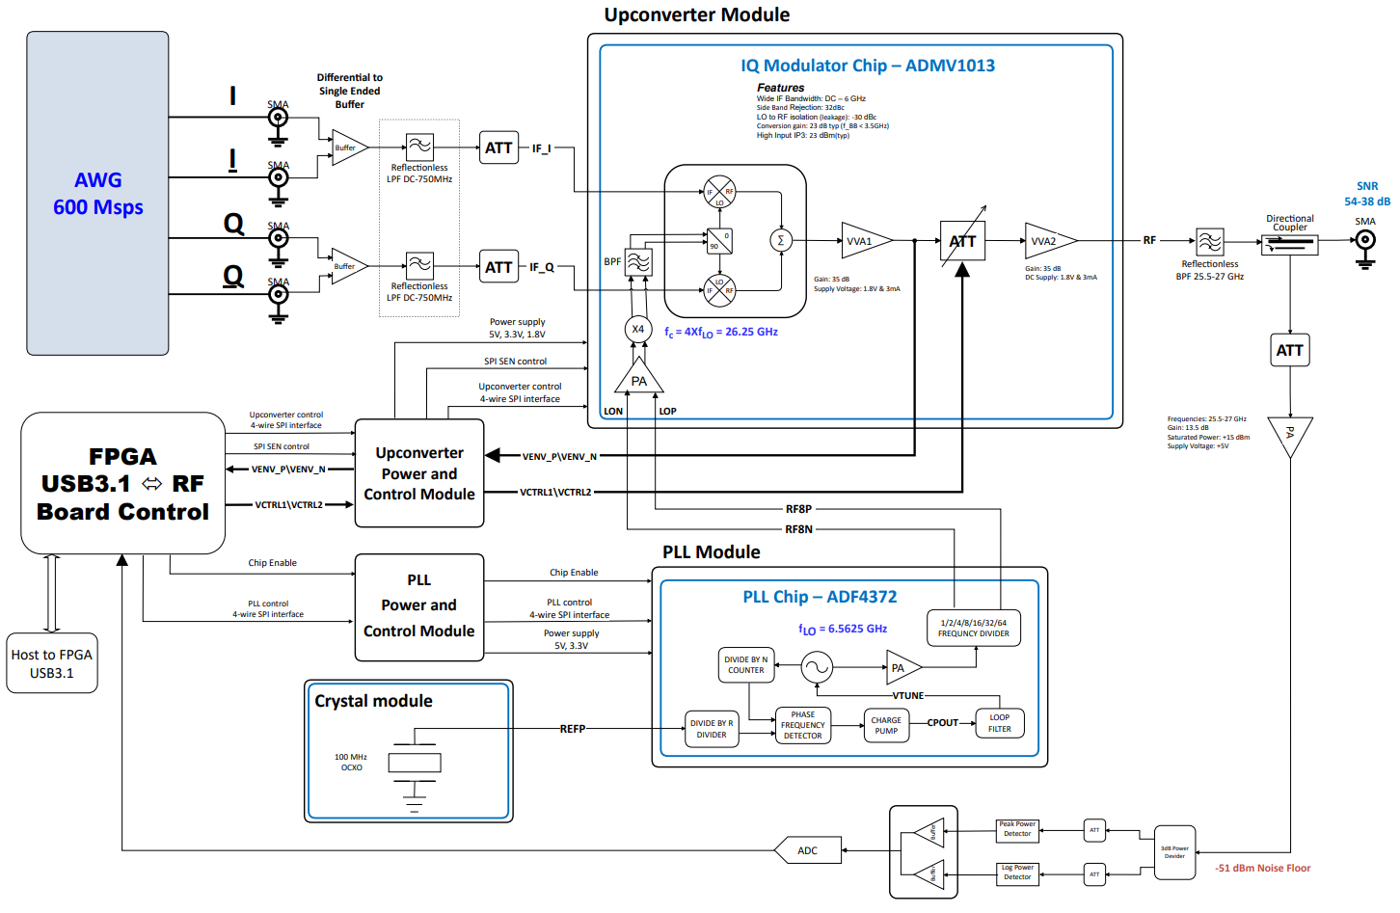
Full System Block-Diagram

Slide 7
Theory

Slide 8
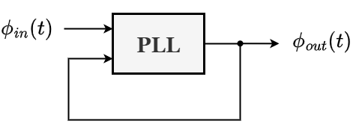
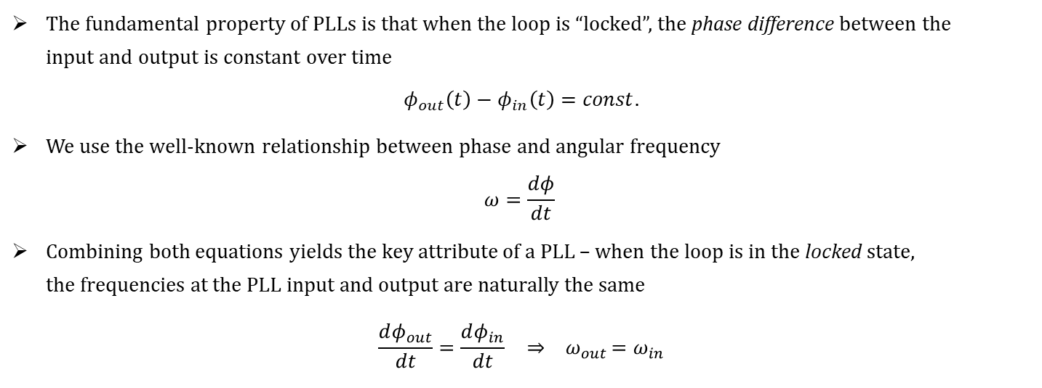
Phase-Locked Loop (PLL) – Conceptual Model
The fundamental property of PLLs is that when the loop is “locked”, the phase difference between the input and output is constant over time
$$φ_{out}\left(t\right)−φ_{in}\left(t\right)=const.$$
We use the well-known relationship between phase and angular frequency $ω=\frac{dφ}{dt}$
Combining both equations yields the key attribute of a PLL – when the loop is in the locked state, the frequencies at the PLL input and output are naturally the same
$$\frac{dφ_{out}}{dt}=\frac{dφ_{in}}{dt} { ⇒ ω}_{out}=ω_{in}$$

Slide 9
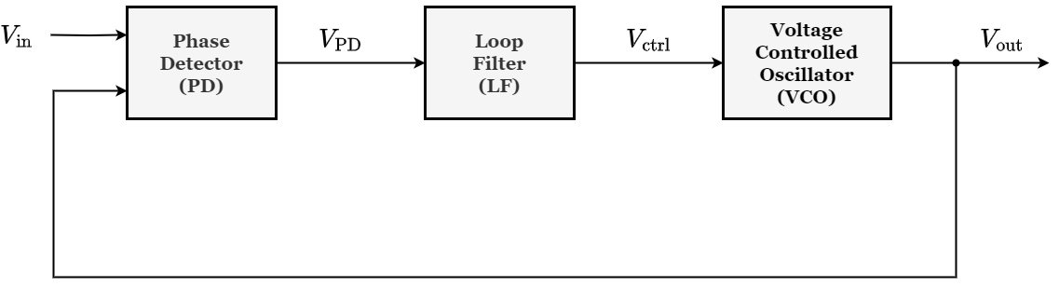
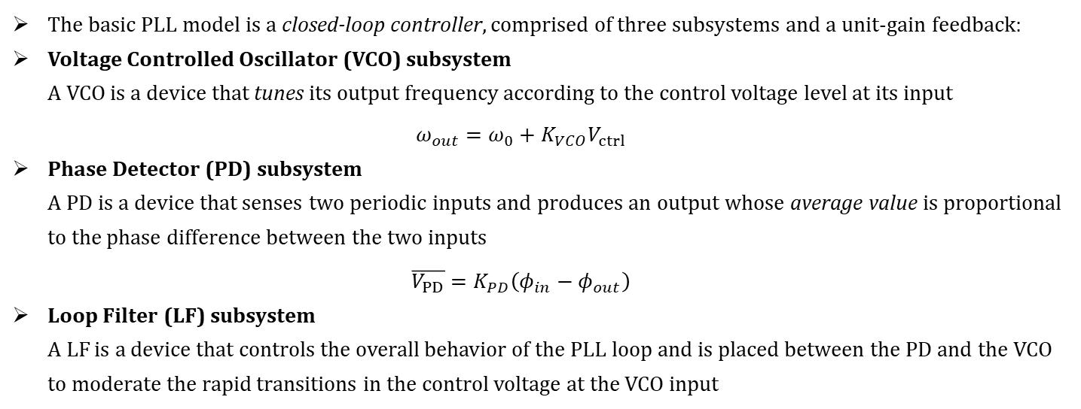
Basic PLL Model
The basic PLL model is a closed-loop controller, comprised of three subsystems and a unit-gain feedback:
Voltage Controlled Oscillator (VCO) subsystem A VCO is a device that tunes its output frequency according to the control voltage level at its input $ω_{out}=ω_{0}+K_{VCO}V_{ctrl}$
Phase Detector (PD) subsystem A PD is a device that senses two periodic inputs and produces an output whose average value is proportional to the phase difference between the two inputs $\overline{V_{PD}}=K_{PD}\left(φ_{in}−φ_{out}\right)$
Loop Filter (LF) subsystem A LF is a device that controls the overall behavior of the PLL loop and is placed between the PD and the VCO to moderate the rapid transitions in the control voltage at the VCO input

Slide 10
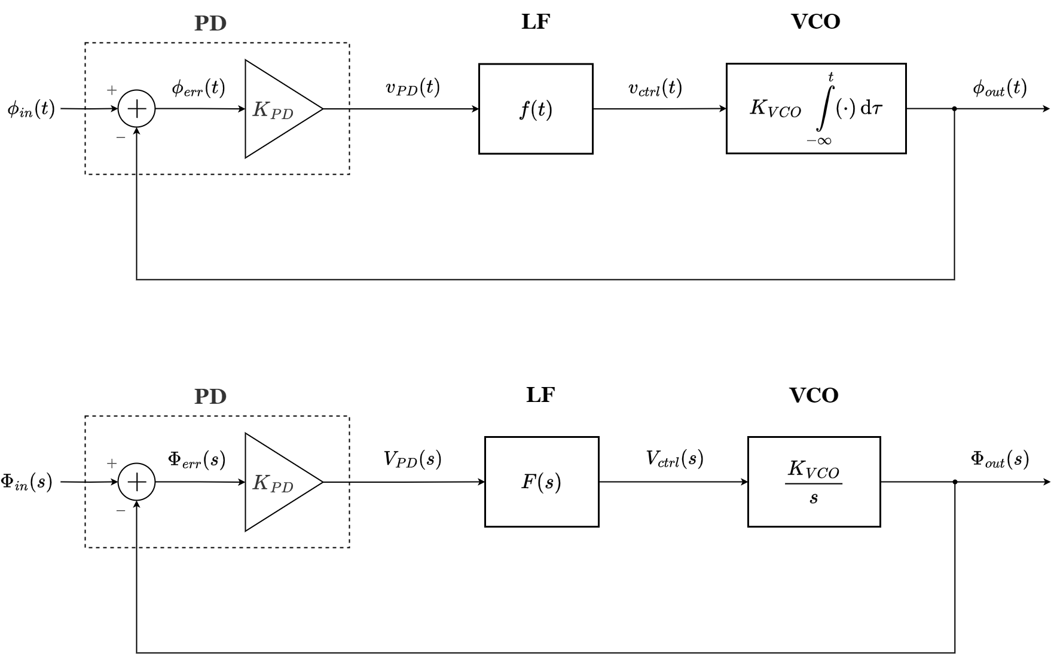
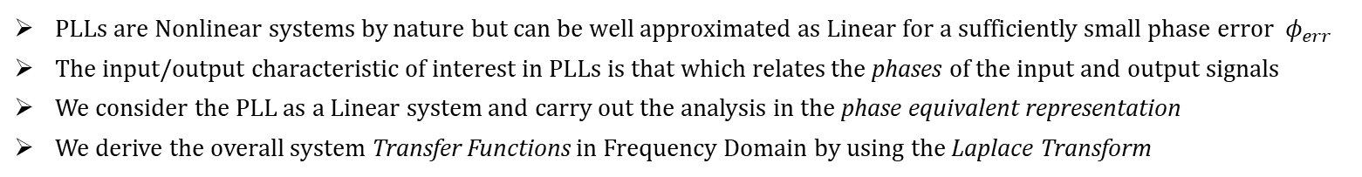
Analysis of a Linear Model for PLLs
PLLs are Nonlinear systems by nature but can be well approximated as Linear for a sufficiently small phase error $φ_{err}$
The input/output characteristic of interest in PLLs is that which relates the phases of the input and output signals
We consider the PLL as a Linear system and carry out the analysis in the phase equivalent representation
We derive the overall system Transfer Functions in Frequency Domain by using the Laplace Transform
Time Domain:
Frequency Domain:

Slide 11
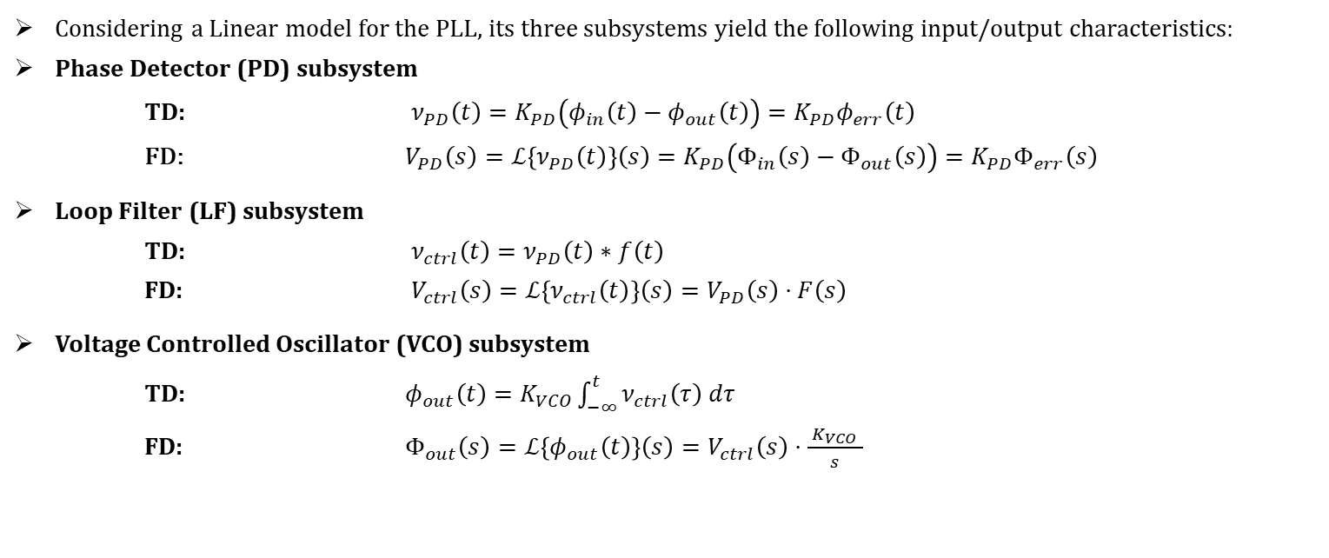
Analysis of a Linear Model for PLLs – Contd.
Considering a Linear model for the PLL, its three subsystems yield the following input/output characteristics:
Phase Detector (PD) subsystem TD: $ν_{PD}\left(t\right)=K_{PD}\left(φ_{in}\left(t\right)−φ_{out}\left(t\right)\right)=K_{PD}φ_{err}\left(t\right)$ FD: $V_{PD}\left(s\right)=ℒ\left\{ν_{PD}\left(t\right)\right\}\left(s\right)=K_{PD}\left(Φ_{in}\left(s\right)−Φ_{out}\left(s\right)\right)=K_{PD}Φ_{err}\left(s\right)$
Loop Filter (LF) subsystem TD: $ν_{ctrl}\left(t\right)=ν_{PD}\left(t\right)∗f\left(t\right)$ FD: $V_{ctrl}\left(s\right)=ℒ\left\{ν_{ctrl}\left(t\right)\right\}\left(s\right)=V_{PD}\left(s\right)⋅F\left(s\right)$
Voltage Controlled Oscillator (VCO) subsystem TD: $φ_{out}\left(t\right)=K_{VCO}\int_{−∞}^{t}{ν_{ctrl}\left(τ\right) dτ}$ FD: $Φ_{out}\left(s\right)=ℒ\left\{φ_{out}\left(t\right)\right\}\left(s\right)=V_{ctrl}\left(s\right)⋅\frac{{ K}_{VCO} }{s}$
Frequency Domain:

Slide 12
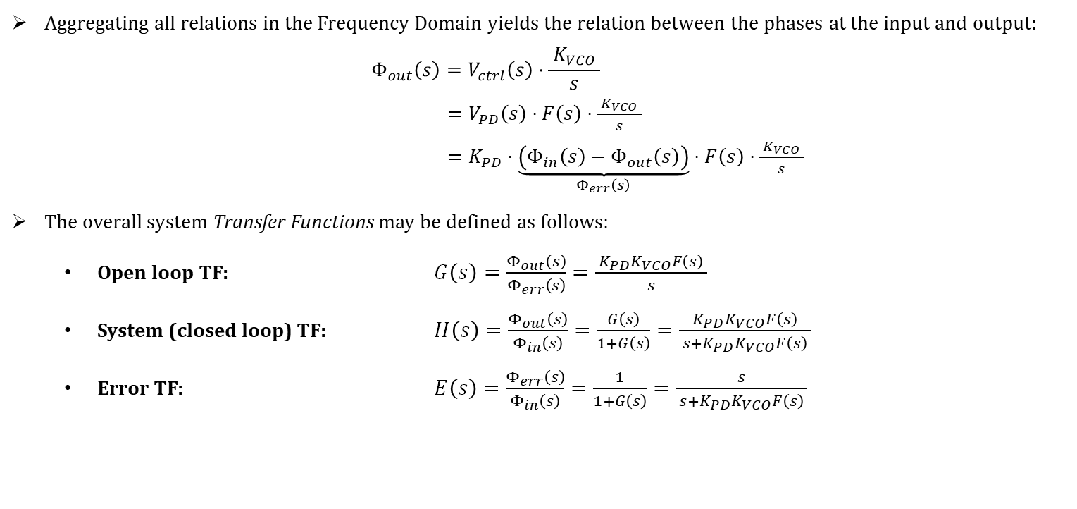
Analysis of a Linear Model for PLLs – Contd.
Aggregating all relations in the Frequency Domain yields the relation between the phases at the input and output:
$$Φ_{out}\left(s\right)=V_{ctrl}\left(s\right)⋅\frac{{ K}_{VCO} }{s}$$ $=V_{PD}\left(s\right)⋅F\left(s\right)⋅\frac{{ K}_{VCO} }{s}$ $=K_{PD}⋅\underset{Φ_{err}\left(s\right)}{\underbrace{\left(Φ_{in}\left(s\right)−Φ_{out}\left(s\right)\right)}}⋅F\left(s\right)⋅\frac{{ K}_{VCO} }{s}$
The overall system Transfer Functions may be defined as follows:
Open loop TF: $G\left(s\right)=\frac{Φ_{out}\left(s\right)}{Φ_{err}\left(s\right)}=\frac{ K_{PD}K_{VCO}F\left(s\right) }{s}$
System (closed loop) TF: $H\left(s\right)=\frac{Φ_{out}\left(s\right)}{Φ_{in}\left(s\right)}=\frac{G\left(s\right)}{1+G\left(s\right)}=\frac{K_{PD}K_{VCO}F\left(s\right)}{ s+K_{PD}K_{VCO}F\left(s\right) }$
Error TF: $E\left(s\right)=\frac{Φ_{err}\left(s\right)}{Φ_{in}\left(s\right)}=\frac{1}{1+G\left(s\right)}=\frac{s}{ s+K_{PD}K_{VCO}F\left(s\right) }$
Frequency Domain:

Slide 13
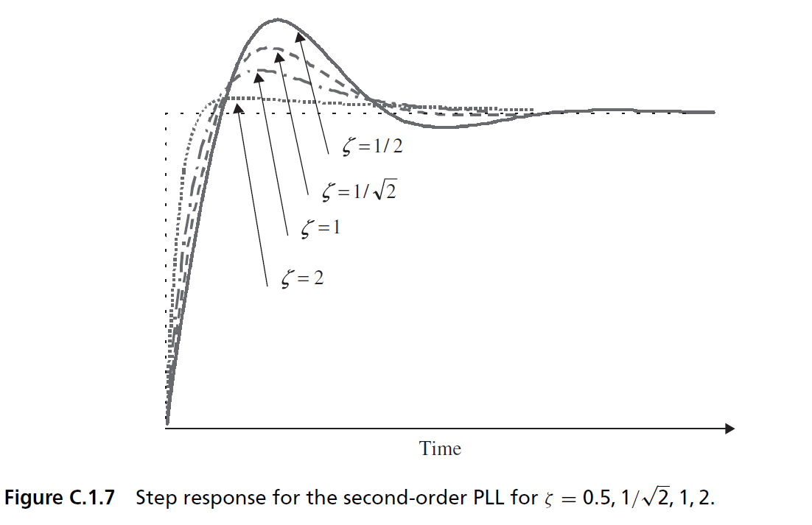
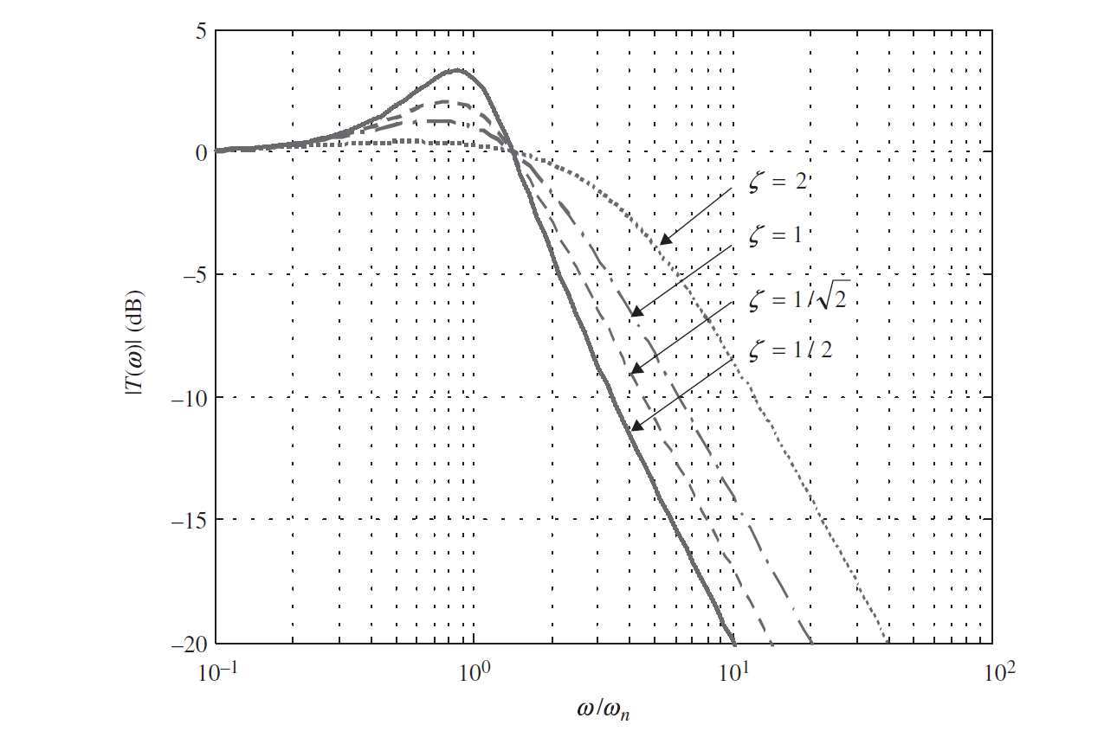
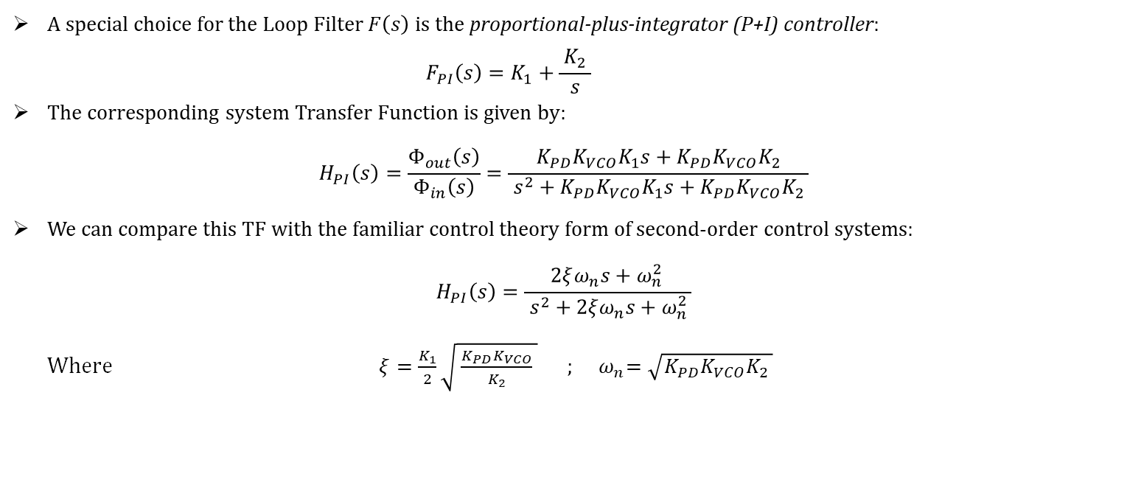
Analysis of a Linear Model for PLLs – Contd.
A special choice for the Loop Filter $F\left(s\right)$ is the proportional-plus-integrator (P+I) controller:
$$F_{PI}\left(s\right)=K_{1}+\frac{{ K}_{2} }{s}$$
The corresponding system Transfer Function is given by: $H_{PI}\left(s\right)=\frac{Φ_{out}\left(s\right)}{Φ_{in}\left(s\right)}=\frac{K_{PD}K_{VCO}K_{1}s+K_{PD}K_{VCO}K_{2}}{ s^{2}+K_{PD}K_{VCO}K_{1}s+K_{PD}K_{VCO}K_{2} }$
We can compare this TF with the familiar control theory form of second-order control systems: $H_{PI}\left(s\right)=\frac{2ξω_{n}s+ω_{n }^{2}}{ s^{2}+2ξω_{n}s+ω_{n}^{2} }$
Where $ξ=\frac{K_{1}}{2}\sqrt{ \frac{{K_{PD}K}_{VCO}}{K_{2}} } ;{ ω}_{n}=\sqrt{K_{PD}K_{VCO}K_{2} }$
Step response
Frequency response

Slide 14
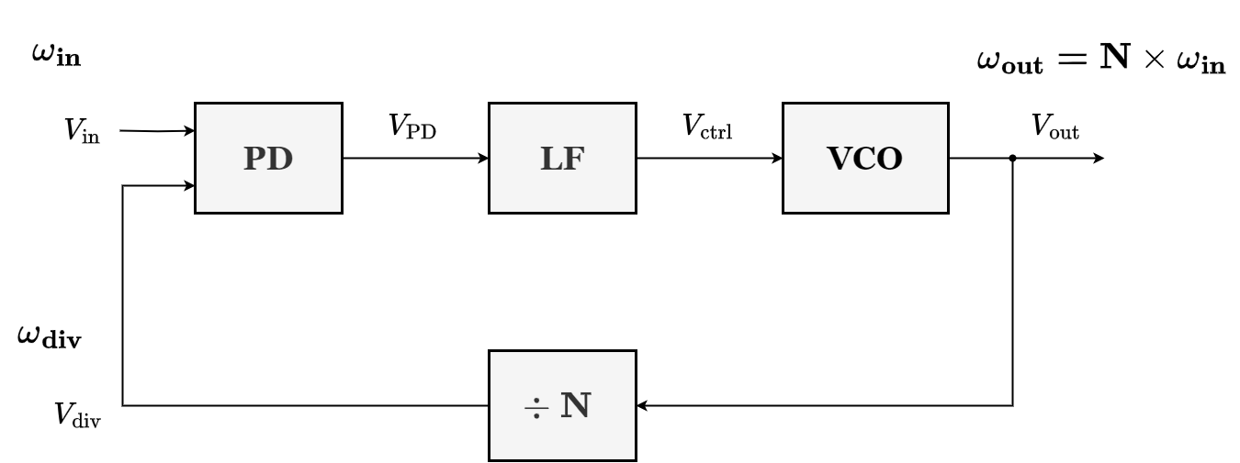
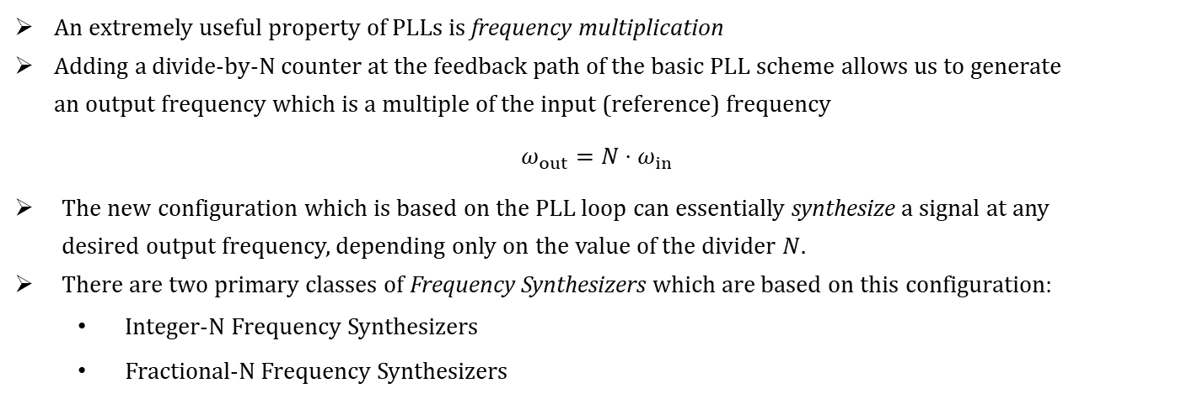
PLL Based Frequency Synthesizers
An extremely useful property of PLLs is frequency multiplication
Adding a divide-by-N counter at the feedback path of the basic PLL scheme allows us to generate an output frequency which is a multiple of the input (reference) frequency
$$ω_{out}=N⋅ω_{in}$$
The new configuration which is based on the PLL loop can essentially synthesize a signal at any desired output frequency, depending only on the value of the divider $N$.
There are two primary classes of Frequency Synthesizers which are based on this configuration:
Integer-N Frequency Synthesizers
Fractional-N Frequency Synthesizers

Slide 15
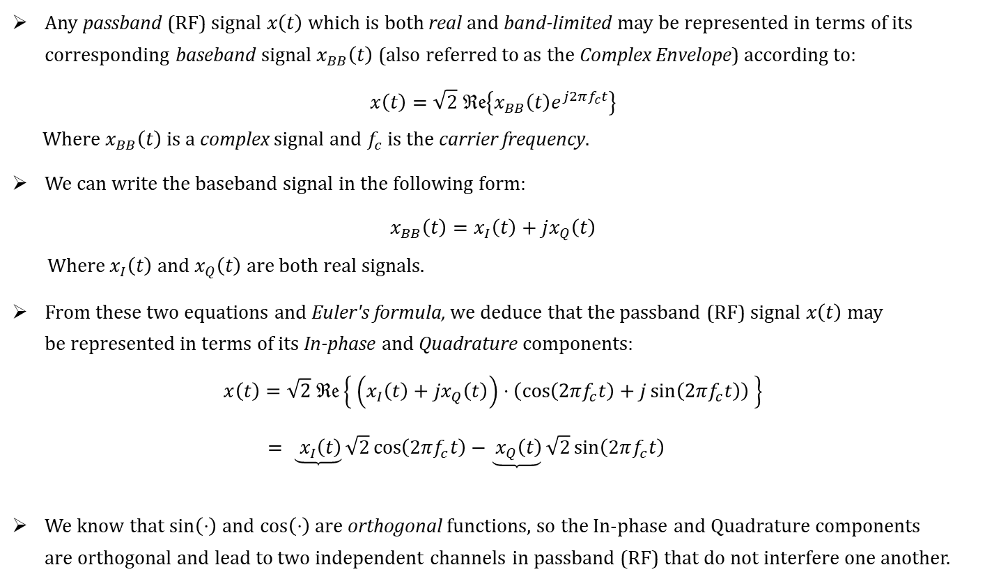
Quadrature (IQ) Modulators
Any passband (RF) signal $x\left(t\right)$ which is both real and band-limited may be represented in terms of its corresponding baseband signal $x_{BB}\left(t\right)$ (also referred to as the Complex Envelope) according to:
$$x\left(t\right)=\sqrt{2} ℜ𝔢\left\{x_{BB}\left(t\right)e^{j2πf_{c}t}\right\}$$
Where $x_{BB}\left(t\right)$ is a complex signal and $f_{c}$ is the carrier frequency.
We can write the baseband signal in the following form:
$$x_{BB}\left(t\right)=x_{I}\left(t\right)+jx_{Q}\left(t\right)$$
Where $x_{I}\left(t\right)$ and $x_{Q}\left(t\right)$ are both real signals.
From these two equations and Euler's formula, we deduce that the passband (RF) signal $x\left(t\right)$ may be represented in terms of its In-phase and Quadrature components:
$$x\left(t\right)=\sqrt{2} ℜ𝔢\left\{ \left(x_{I}\left(t\right)+jx_{Q}\left(t\right)\right)⋅\left(\cos\left(2πf_{c}t\right)+j\sin\left(2πf_{c}t\right)\right) \right\}$$
$= \underbrace{ x_{I}\left(t\right)}\sqrt{2}\cos\left(2πf_{c}t\right)−\underbrace{{ x}_{Q}\left(t\right)}\sqrt{2}\sin\left(2πf_{c}t\right)$
We know that $\sin\left(⋅\right)$ and $\cos\left(⋅\right)$ are orthogonal functions, so the In-phase and Quadrature components are orthogonal and lead to two independent channels in passband (RF) that do not interfere one another.
In-phase
Quadrature

Slide 16
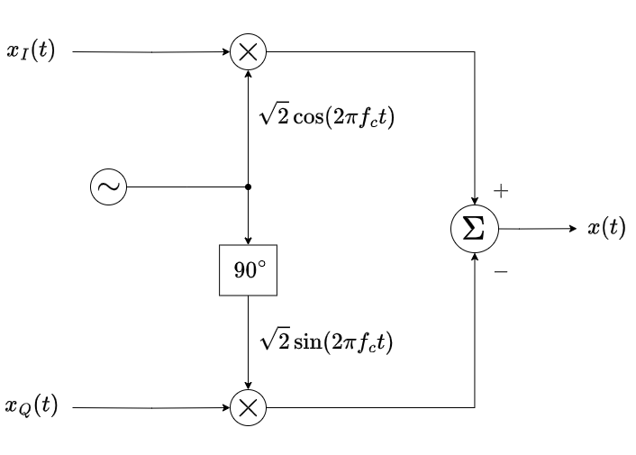
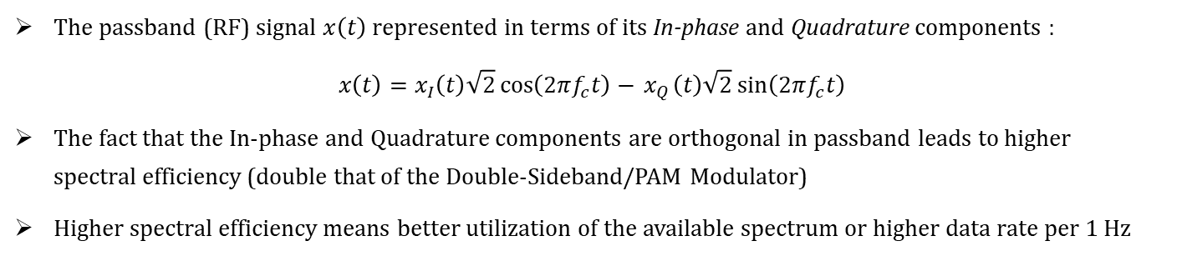
Quadrature (IQ) Modulators – Contd.
The passband (RF) signal $x\left(t\right)$ represented in terms of its In-phase and Quadrature components :
$$x\left(t\right)=x_{I}\left(t\right)\sqrt{2}\cos\left(2πf_{c}t\right)−{ x}_{Q}\left(t\right)\sqrt{2}\sin\left(2πf_{c}t\right)$$
The fact that the In-phase and Quadrature components are orthogonal in passband leads to higher spectral efficiency (double that of the Double-Sideband/PAM Modulator)
Higher spectral efficiency means better utilization of the available spectrum or higher data rate per 1 Hz
In-phase:
Local Oscillator
Quadrature:

Slide 17
Design

Slide 18
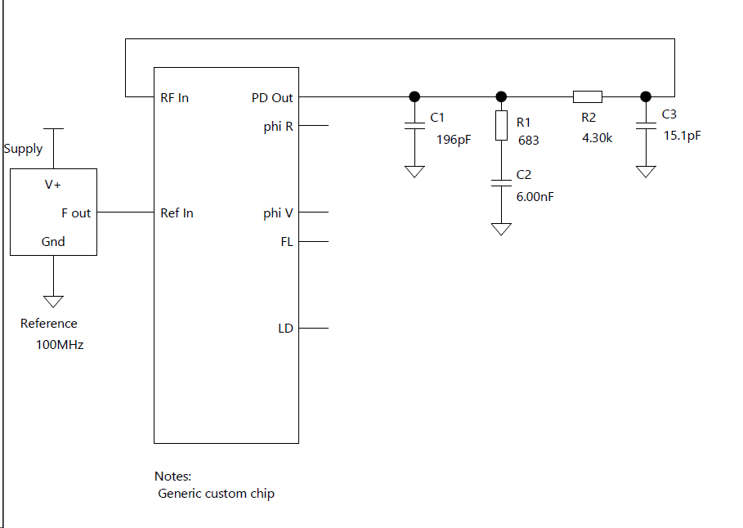
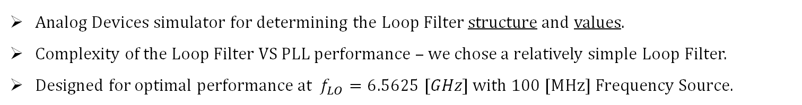
ADIsimPLL – Simulation
Analog Devices simulator for determining the Loop Filter structure and values.
Complexity of the Loop Filter VS PLL performance – we chose a relatively simple Loop Filter.
Designed for optimal performance at $f_{LO}=6.5625 [GHz]$with 100 [MHz] Frequency Source.
Loop Filter
Frequency Reference Source
PLL ADF4372

Slide 19
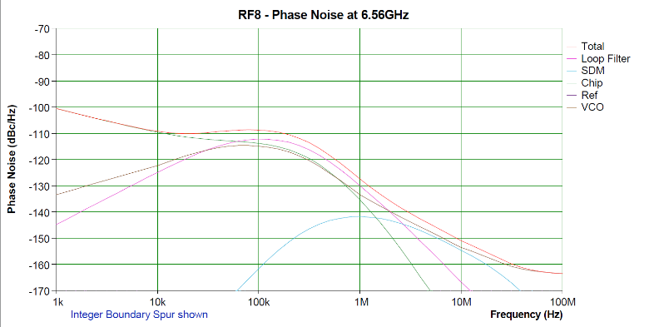
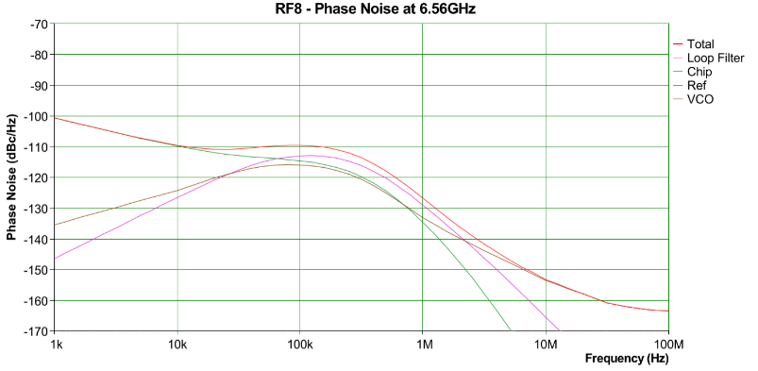
ADIsimPLL – Simulation
With and without Fractional-N – insignificant improvement vs special Crystal Oscillator (not an integer frequency value)
(a)
(b)

Slide 20
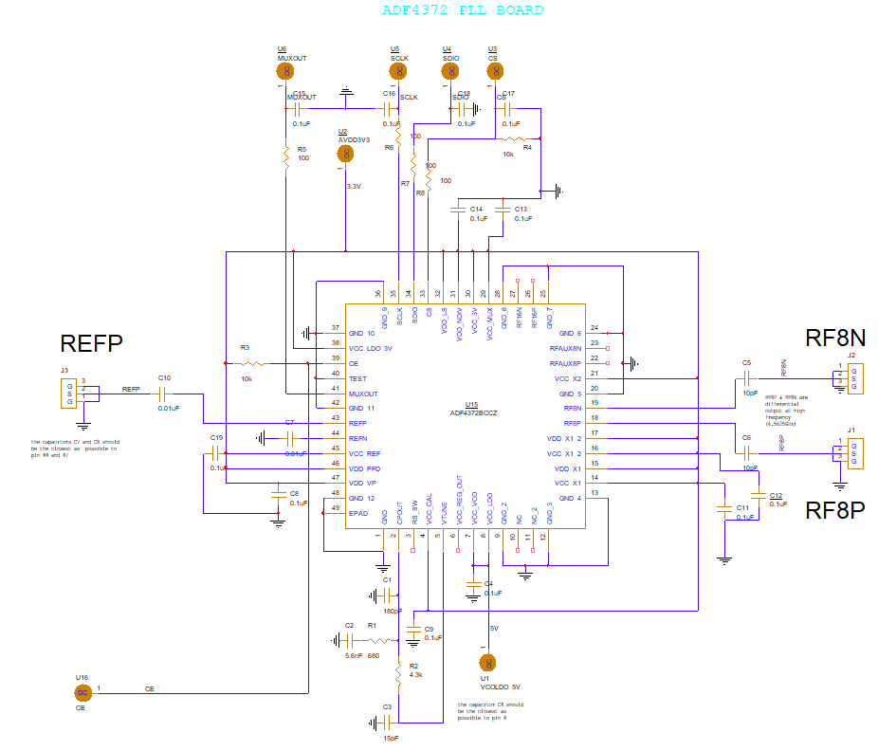
PLL Schematic Design
Resources – Data Sheet, Evaluation Board, X-microwave design
8 [GHz] vs 16 [GHz] versatility
Loop Filter
Differential Signaling output
DC filtering on the RF wires
Power pins AC decoupling
SPI RC (LPF) filtering
Learning on the way…
SPI control
Frequency Source Input
RF Out Negative (LO_N)
RF Out Positive (LO_P)
Loop Filter

Slide 21
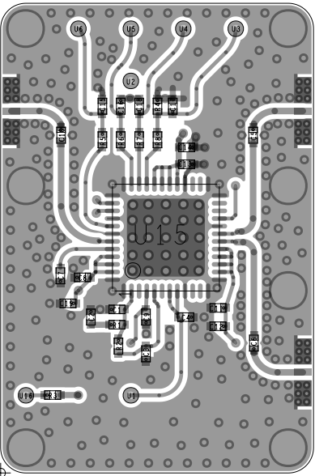
PLL Board Design – Top Layer
4 layers Board – Top, Ground, Power, Bottom
Resources – Menashe and Denis ☺
Design stages by priority – RF first!
Differential Signaling – length
RF wiring and Connectors build with Ground “fence”
Curved RF wires for better transition
Loop Filter – Lumped Circuit
Power pins AC filtering – near the pins (limited space)
Constraint to X-microwave Form Factor and Grid
Vias on the Grid for the Power and Control Board - Back Drilling
SPI control
Frequency
Source
Input
RF Out Negative
RF Out Positive
Loop Filter

Slide 22
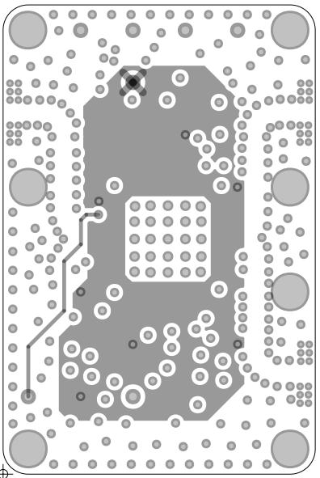
PLL Board Design – Power Layer
Big 3.3V Power Plain – for stable Power distribution
Chip Enable
Chip Enable
3.3V Power Plain

Slide 23
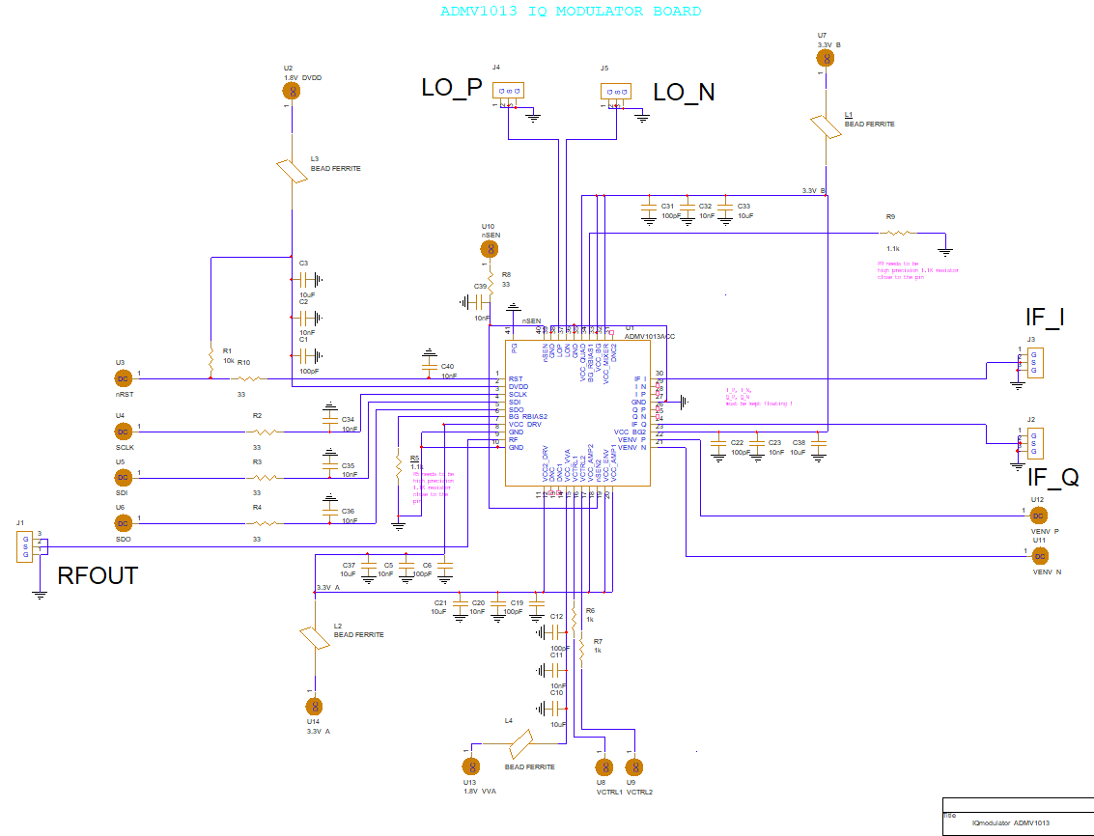
Upconverter Schematic Design
Resources – Data Sheet, AD-Evaluation Board, X-microwave design
Differential Signaling input – Local Oscillator
Power pins AC filtering with Ferrite Bead – Higher frequency -> more filtering
SPI RC filtering
VENV_P/N for RF out Amplitude Power Detection
VCTRL1/2 for Attenuator Variation According to VENV detection
SPI control
VCTRL1/2
VENV_P/N

Slide 24
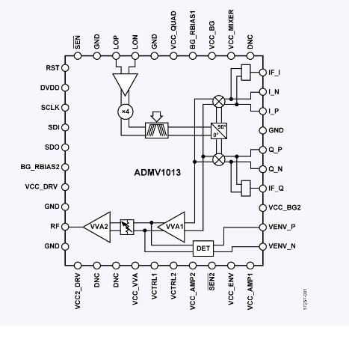
Upconverter Schematic Design – Chip internal
IQ Modulator
Differential LO input Quadrupole
Voltage Envelope Detector - VENV
Voltage Control for Attenuator Variation
Local Oscillator
IQ Modulator
Baseband
Variable Attenuator
Voltage Control Pins

Slide 25
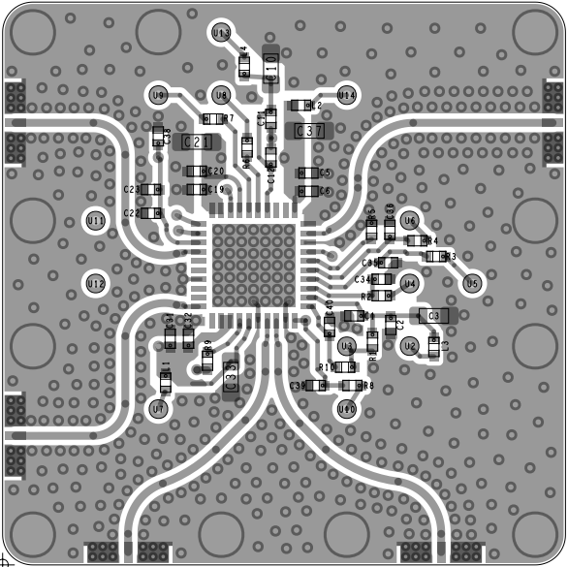
Upconverter Board Design – Top Layer
4 layers Board – Top, Ground, Power, Bottom
Design stages by priority – RF first
Differential Signaling – same length
RF wiring and Connectors build with Ground “fence”
Curved RF wires for better transition
Power pins AC filtering – more filtering then the PLL (Higher Frequency)
Ferrite Bead in the Power inputs – spike protection
Same Constraint to X-microwave Form Factor and Grid
Vias on the Grid for the Power and Control Board - Back Drilling
VCTRL 1/2
IF_Q
RF Out
SPI Control
VENV_P/N
IF_I
LO_N
LO_P

Slide 26
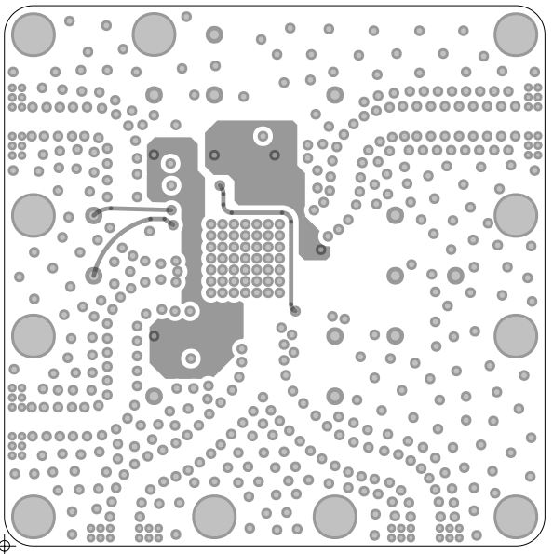
Upconverter Board Design – Power Layer
2 Power Plain for 3.3VA and 3.3VB – for stable distribution
VENV chip to via connection
nSEN signal connection
3.3VA
VENV P/N
nSEN – SPI Enable
3.3VB

Slide 27
Conclusions
Results and testing – system has not been tested de-facto yet and remaining stages of the design should be carried out by future projects in order to complete the full system
Hardware projects – making a complex hardware system become a reality is quite challenging
RF systems – the main considerations are minimizing the noise and proper integration of the different subsystems
System design – experience, experience, experience…
Theoretical foundation – it is extremely important to start at this stage and dig deep!
Board Design – learning curve can only be achieved by trial and error (ping-pong with Denis and Menashe)
Teamwork – Makes the dream work!
Experience – consult with experienced and knowledgeable figures (like Denis and Menashe) as much as possible
Documentation and backups – very important for efficiency and future reference

Slide 28
Q&A

Slide 29
Thank You!

